Slide 1
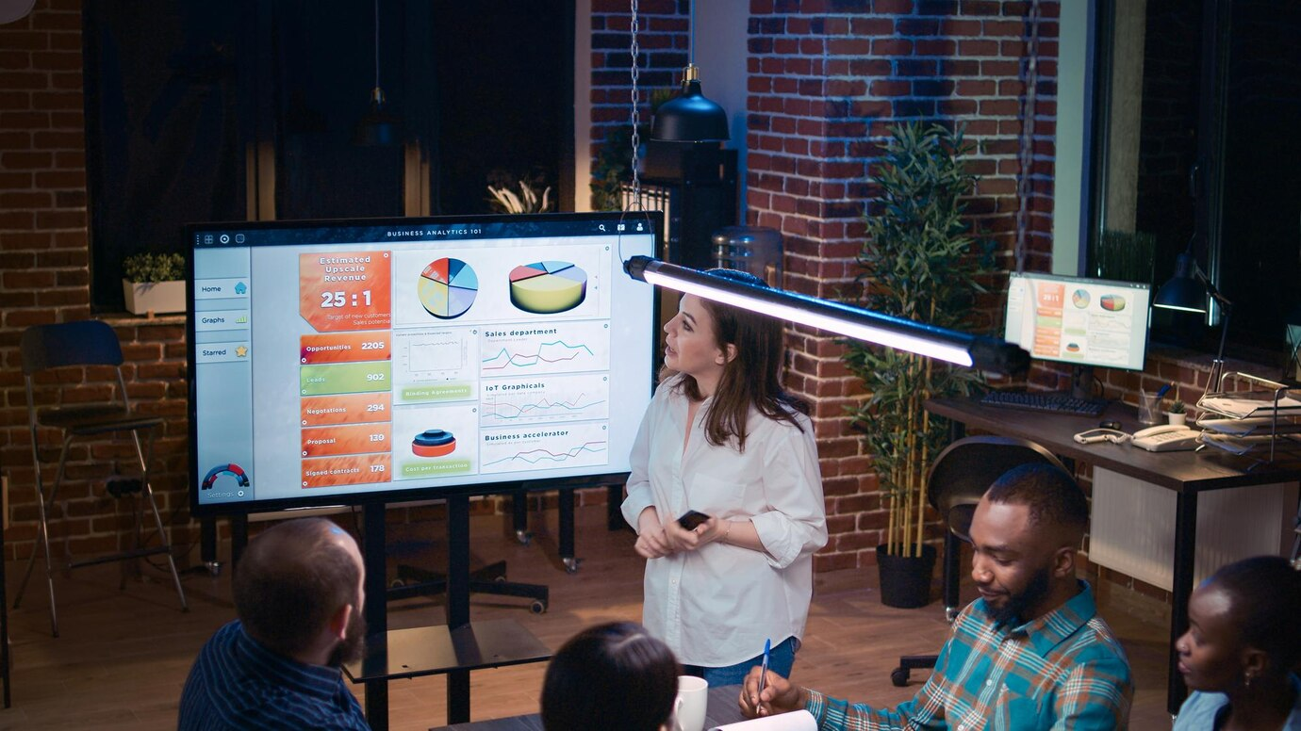

SOP – Pitch to Close Pillar III – Pitch Deck Date of Publication : 24/11/23

Slide 2
Standard Format of Pitch Deck
Cover page
Who we are?
Founder’s profile (Meet the team)
Core team
Traction and Milestones (If they have)
Challenges/ Problem statement
Solution
Market overview
Target market
Market size
Competitive Landscape
Unique selling propositions
Testimonials and Reviews
Funding in the industry
Go to market strategy
Roadmap
Financials (if needed) | KPI Dashboards
Ask and usage
Appendix
References
Challenges and trends in the industry
Industry specific certifications
Success stories
Case Study of competitors
Awards and recognition
Media Coverage
This is the initial framework, which can be modified by adding or removing slides according to the narration that the client wants.

Slide 3
Pitch Deck – Process Flow
Step 2: Market Research and Analysis
2
3
Step 3: Competitive Landscape analysis
1
4
Step 1: Information | Input Gathering
Step 4: Ascertaining inputs for financials | KPI Dashboard, “ask and usage slide” from the financial model
5
6
Step 5: Putting the deck together
Step 6: Review and Refinement
Ideally, all these process except step 6 happen parallelly for financial model assumptions as well.

Slide 4
Step 1: Information | Input Gathering
Identifying client aspirations
Resonating with the business models and uniqueness
Recognition of business process and opportunity
Understanding of business products and services
Getting to know about “the team”
Understanding and developing a GTM Strategy with the client

Slide 5
Step 2: Market Research and Analysis
Identifying the target market size and growth potential(CAGR)
Identifying the revenue drivers, general trends, challenges
Identifying big players and their market share
Establishing industry specific KPIs and key metrics of performance
Target audience, target geographies and target associations
Establishing TAM, SAM, SOM
TAM – Total accessible market – which is the overall market size
SAM – Serviceable addressable market – which is the niche specific market size
SOM – Share of market – which is taken from the revenue of the last year of the financial model
In comparison to global market, how are the clients doing, are the aspirations global or local
Funding in the industry
Notes:
Establish where we gather tam, sam and som from.

Slide 6
Step 3: Competitive Landscape
Searching for the companies that have similar business activities as our clients
Examining their online platforms and evaluating certain factors that help our client company distinguish itself from them
Exploring the factors that are consistent with the industry or service.
To find the differentiator

Slide 7
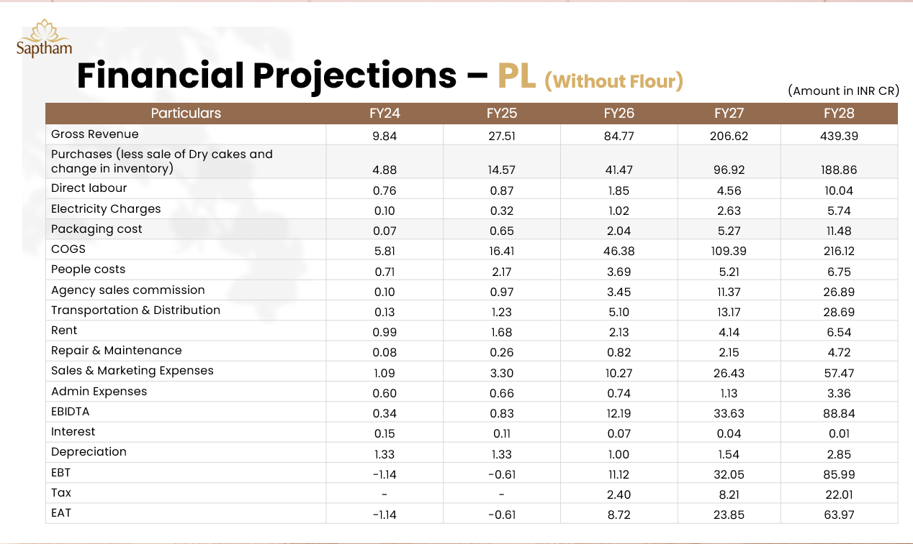
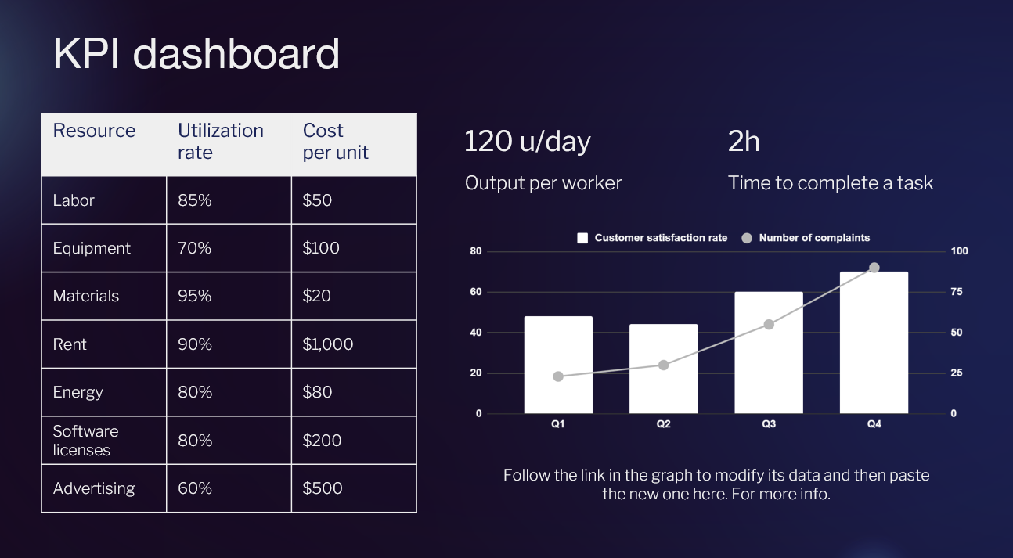
Step 4: Financials | KPI Dashboard
Projections of P/L, Unit economics and Cashflow
Earlier
Going Forward

Slide 8
Step 5: Putting the deck together
Creating the narrative arc
Using storytelling techniques
Connecting with the audience
Taking inputs for The narration flow

Slide 9
Inputs for Various Slides
Slide Name | Input | Input Source
Cover Page | Stock image based on the product or service the client offers | Pexels.com, Pinterest.com
Who We Are | Information about the client's operations, industry, and other relevant details | Client | Company’s website
Meet the Founder | Information about the founder's professional experience, alumni status, and education | Client and LinkedIn
Core Team | Advisors | Client and LinkedIn
Challenges/Problem Statement | Problems the client solves based on their market gap analysis | Client
Solutions | The client's approach to addressing the problems within their niche. Product demo video with voice over | Product screen | Relevant Dashboards | Client
Market Overview | The growth potential, revenue, market size, major players | Market research – Statista, Grandview research etc
Notes:
Add to go to market strategy – inputs : client and FC team

Slide 10
Inputs for Various Slides
Slide Name | Input | Input Source
Target Market | Target geographies, industries, customer segments and target associations | Client | Guesstimates from Market research
Market Size | TAM, SAM, SOM | Market research | Financial Model
Competitive Landscape | Metrics used to differentiate the client’s company from other companies in the same line of business | Metrics are taken after skimming all of the competitor’s website and other online presence document
Go to market strategy | Product positioning, customer segmentation, value proposition, pricing strategy, distribution channels | Client and FC Team
Testimonials and Reviews | Product | Service testimonials and reviews from customers, partners, associations | Client | Company Website

Slide 11
Inputs for Various Slides
Slide Name | Input | Input Source
Unique Selling Proportions | Information about the differentiator of client’s company and what gives them the edge | Client
Funding in the industry | Revenue, valuation, latest funding, total funding and key investors of those companies which received funding in this industry | Crunchbase, Traxcn
Roadmap | The revenue and any other key metrics that will be used to track ROI and progress | Financial model
Financial | KPI Dashboard | Profit & Loss, Unit economics and Balance sheet | Financial model
Ask and Usage | The client’s funding needs and where this fund will be used | Client, Financial workings
Appendix | References, Challenges | trends in industry, Success stories, Awards and recognition, Media coverage | Market research | Client

Slide 12
Review and Refinement
The preliminary draft | MVP [Minimum Viable Product] will take a minimum of 14 days to create.
This MVP will be send to the client engagement manager and Principal consultant for review first.
Following the presentation of this deck to the client, a comprehensive review will be conducted to solicit their feedback. Subsequent to receiving the client's opinions, any necessary adjustments will be made to enhance the effectiveness of the content.
Subsequent to the preparation of the financial model, the deck undergoes a thorough review by both CFO and the client.
Notes:
Rephrase point 3 tone = professional

Slide 13
General Instructions
Fonts Used:
Headings – Poppins
Body - Tenorite
Dos | Don’ts
Keep it simple and focused, 16 – 20 slides are optimal | Don’t make it too long
Hook the audience through the narration | Having unstructured schema for the slides
Using visuals, icons and infographics, bullet points | Having too many texts
The theme of the slides must be in unison of the client logo | Don’t use bright | bold colors,
Referencing our sources of market research | Don't make unsubstantiated claims. Make sure all information is factual

Slide 14
General Challenges
We currently face limitations in our ability to access comprehensive research libraries, which impacts our ability to obtain in-depth reports on specific industries. Presently, we are confined to publicly available, unpaid information that is frequently unreliable and lacks specificity.
Our current challenge lies in the absence of expertise in UI/UX design. We currently do not have access to UI resources such as Canva Pro or Envato Elements.

